Slide 1

SGLT2-inhibitors
for late stage CKD?
CKD G4/5, dialysis & transplantation
ron Gansevoort, MD PhD, FERA, FASN
Prof. Medicine
Director of the Groningen Kolff Center for Kidney Research
UMC Groningen, the Netherlands
NL-11279 prod.3/23
Notes:
I would like to take this assignment even somewhat broader and addres the question what the value of SGLT2 inhibitopn is in late stage CKD, so not only patients with a kidney transplant or on dialysis, but also what their value is in patients with CKD stage G4-5, i.e. a GFR <30 ml/min

Slide 2
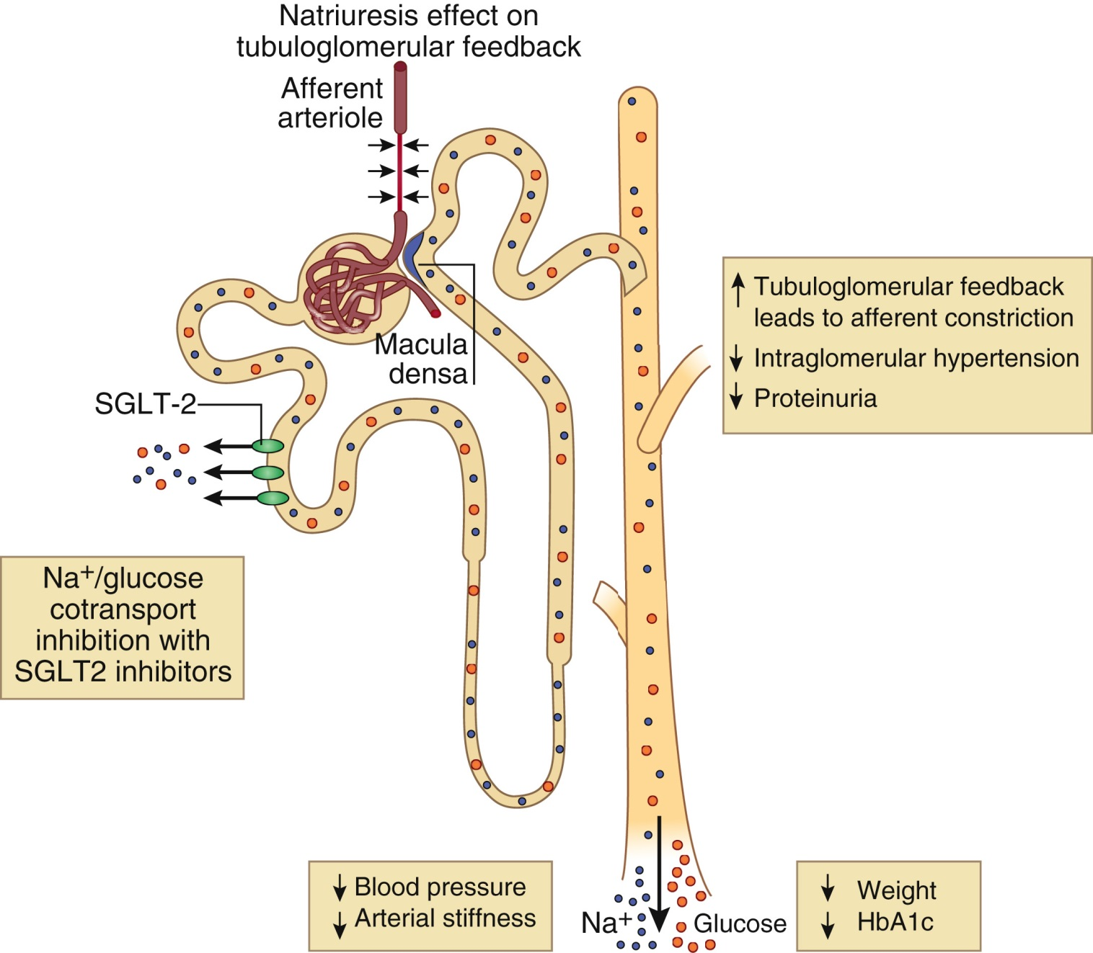
SGLT-2-inhibitors Mode of Action
Lambers Heerspink et al, Kidney Int 2018;94:26-39
Notes:
And why would this topic have to be discussed separately? But when in late stage CKD you have hardly any nephrons left, so hardly any tubular SGLT2, how could these drugs be effective?

Slide 3
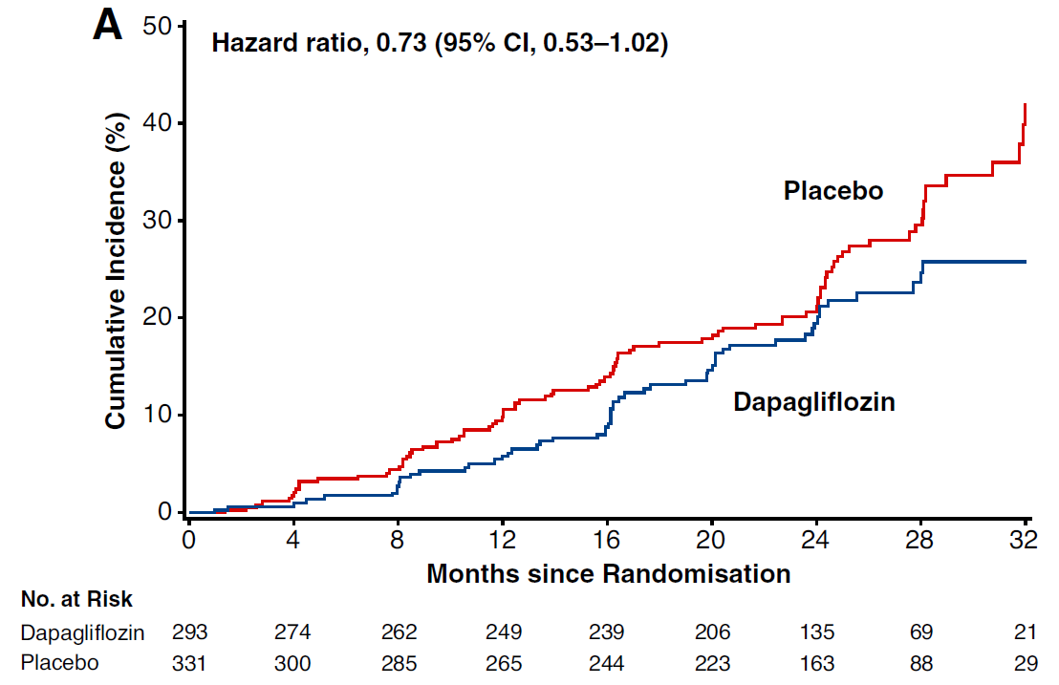
The DAPA-CKD trial Severely impaired eGFR, does it matter ?
Participants:
CKD with or without T2D, eGFR 25-30 ml/min, n = 624
Primary outcome:
Incidence of 50% decrease in eGFR, kidney failure,
or renal and cardiovascular mortality
DAPA-CKD inclusion: eGFR 25-75 mL/min/1.73m2 and ACR >200 mg/g
Chertow et al, JASN 2021;32:2352-2361
Notes:
Now let’s review the landmark studies that have been perfomred with SGLT2i in patients with CKD, whether there is a dependency of baseline eGFR

Slide 4
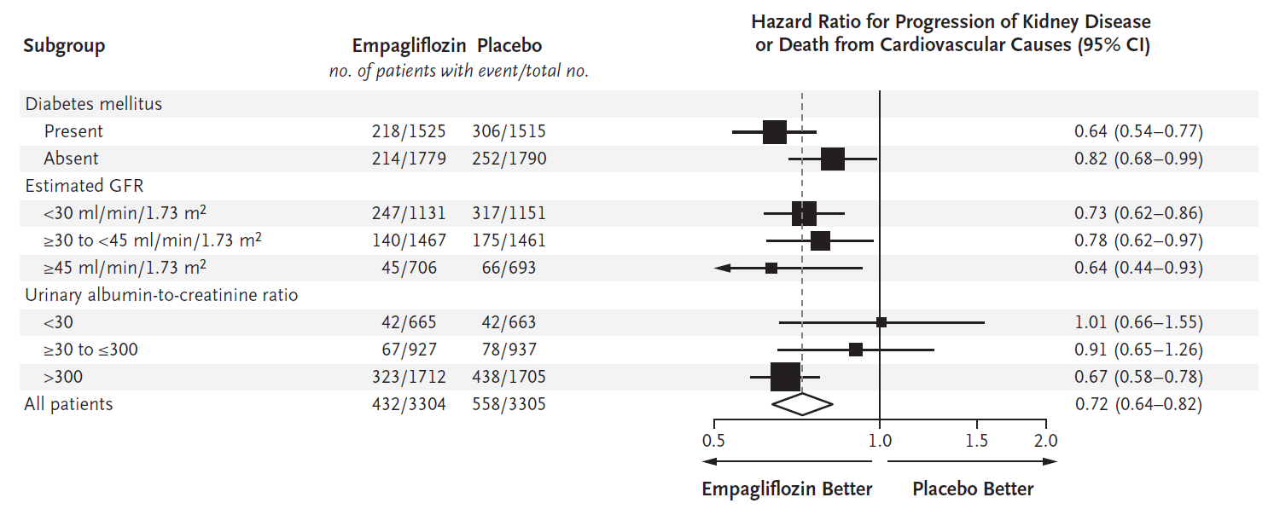
The EMPA-KIDNEY trial Severely impaired eGFR, does it matter?
Inclusion: eGFR 20-45 OR eGFR 45-75 mL/min/1.73m2 and ACR >200 mg/g
Herrington et al, N Eng J Med 2023;388:117-27
Notes:
But this is the combined endpoint of progression to kidney failure or death from CV causes. What happens when we look at the kidney and the cardiovascular outcome seperately.

Slide 5
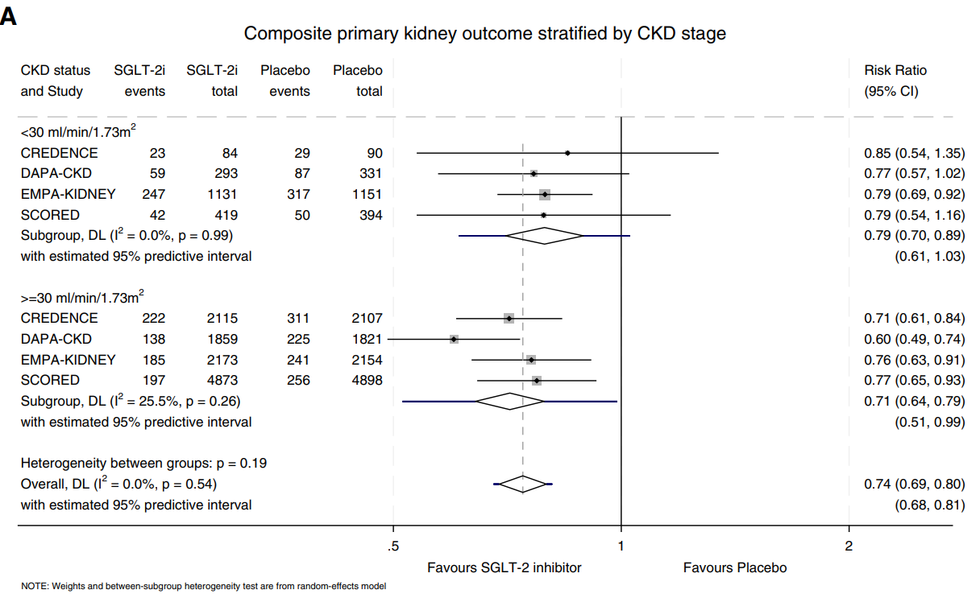
SGLT2 inhibition in KDIGO eGFR stage 4/5 Composite kidney outcome
Worsening kidney function, kidney failure and kidney death
Meta-analyis of the pivotal phase 3 RCTs including patients with an eGFR<30
Elenjickal et al, cJASN 2025;20:788-09
Notes:
That was done in this meta-analysis that was published soem motnhs ago in cJASN. Here you see the effect of SGLT2i on the kidney outcome in GFR >30 versus <30 so CKD stgae G4/5.

Slide 6
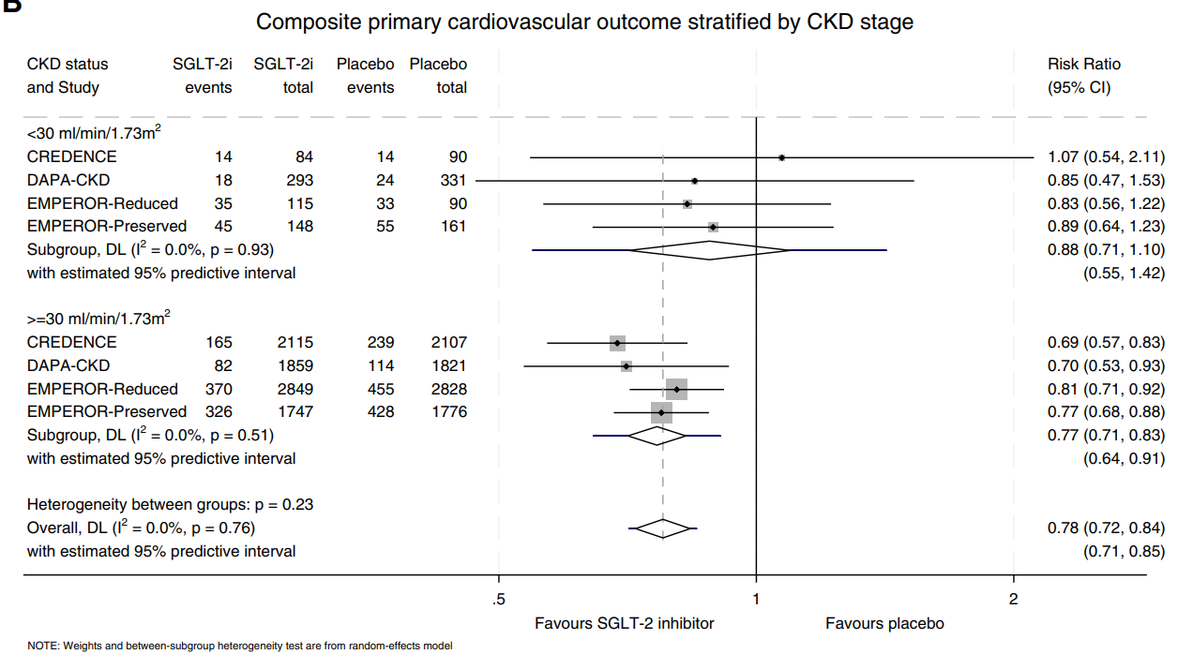
SGLT2 inhibition in KDIGO eGFR stage 4/5 Composite CV outcome
CV death or hospitalization for heart failure
Meta-analysis of the pivotal phase 3 RCTs including patients with an eGFR<30
Elenjickal et al, cJASN 2025;20:788-09
Notes:
This meta-analysis also showed the effects for specifically the cardiovascular outcome. Perhaps slighyl lower, but also an issue of power., and at least no sign for effect modification.

Slide 7
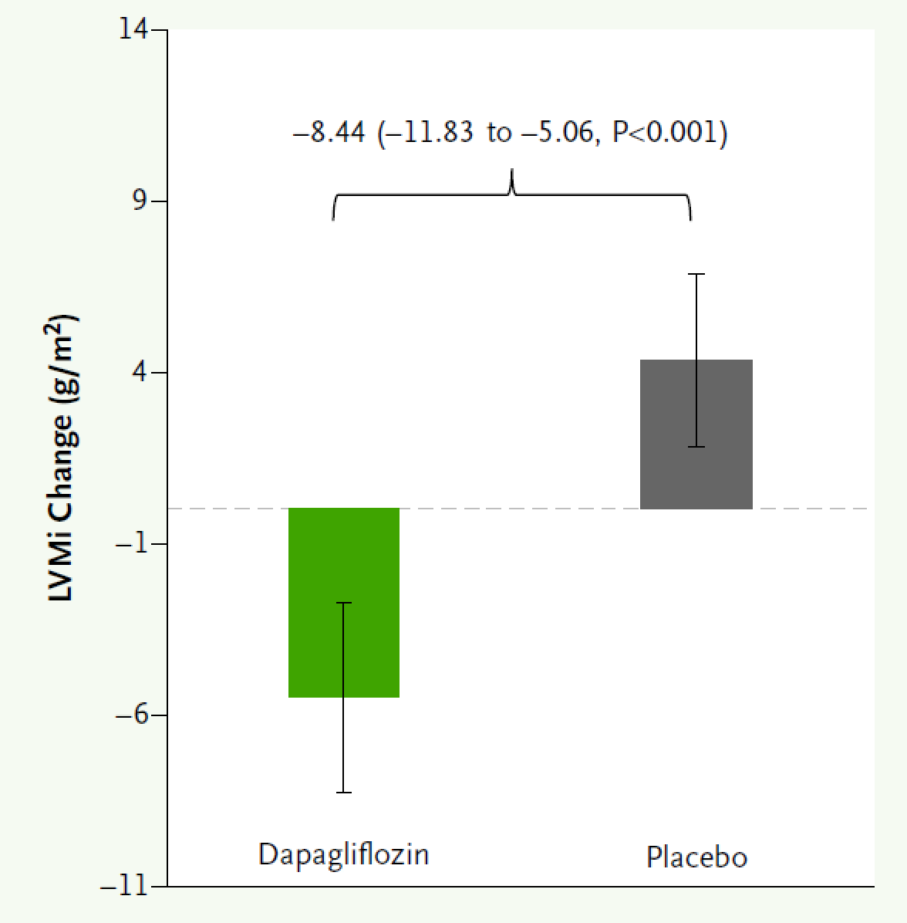
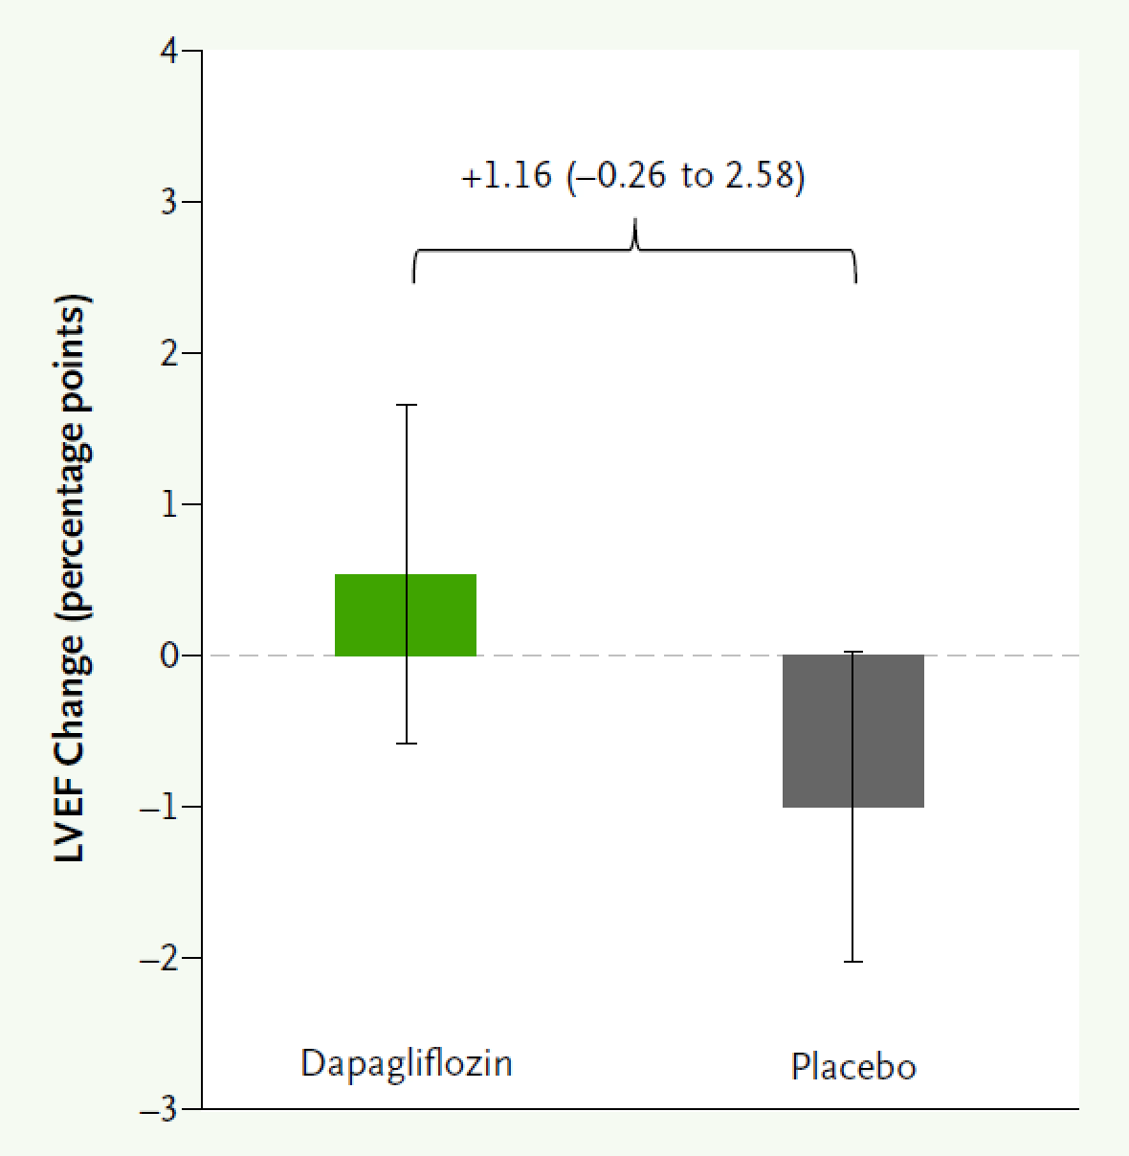

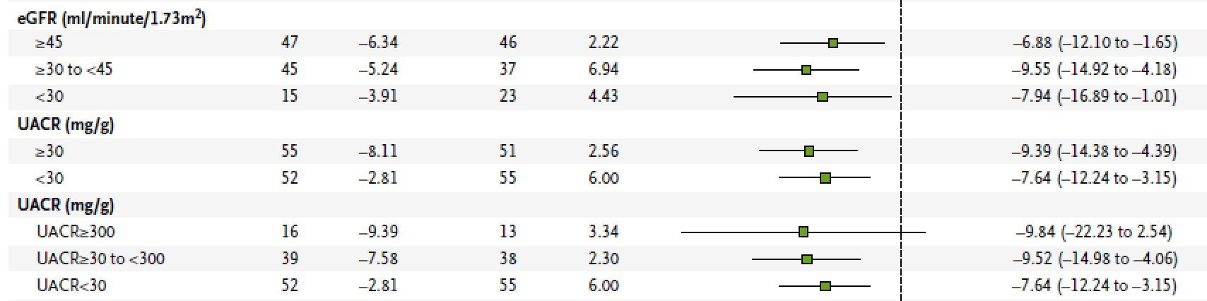
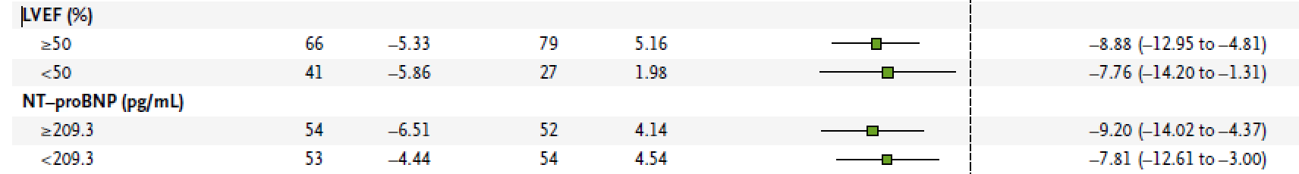
SGLT2 inhibition in patients with CKD Effects on LVM and EF independent of eGFR
LVM
LVEF
Effect on LVMI across subgroups
RCT in 222 patients with CKD (eGFR<60 or ACR >200 mg/g)
Either 6 months of dapagliflozine 10 mg or matching placebo
Bartholdy et al
New Eng J Med Evidence 2025 (epub ahead of print)
Notes:
Such direct effects on the heart were also suggested by this study that was published two weeks ago in the NEJM Evidence. It investigated the effects of 6 months of treatment with dapa versus placeco on LVMI and LVEF. And when these authors investigated whetehr this effect was different

Slide 8
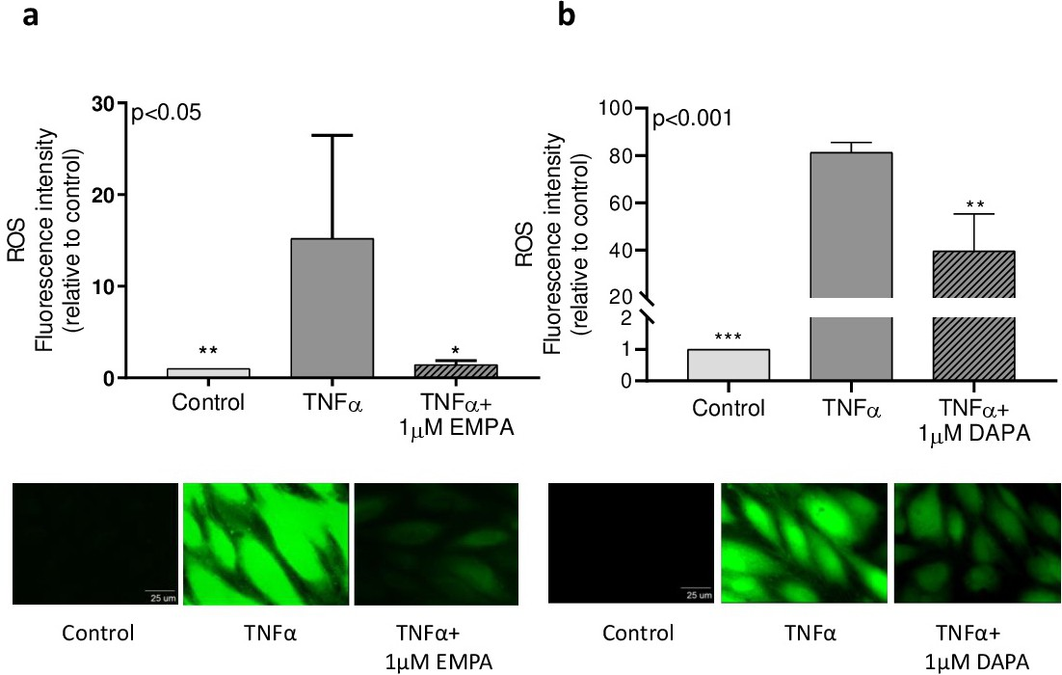
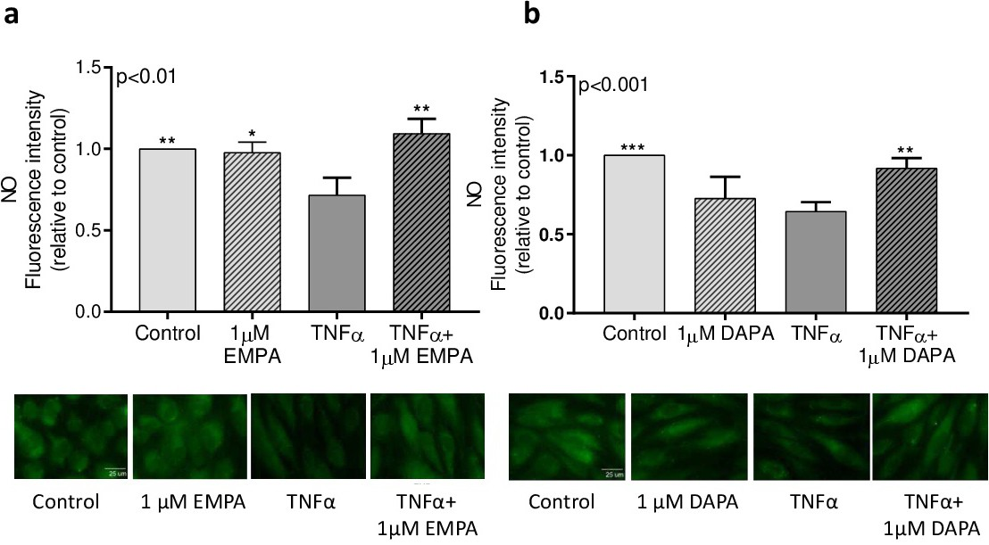
SGLT2 inhibition Cardiovascular effects independent of tubular SGLT2 ?
Reactive Oxygen Species (ROS) levels
Vasoconstricting
Nitric oxide (NO) levels
Vasodilating
In vitro stimulating growth of human coronary artery endothelial cells with TNFα / SGLT2i
Uthman et al, Cell Physiol Biochem 2019;53:865-886
Notes:
Experimental study: endotheelcellen van ((((humane)))) coronair arterien die in kweek zijn gebracht.
TNFa is een mediator van de stress respons. Leidt tot productie van vasoconstrictieve stoffen en minder vasodilatoire stoffen
Deze respons kan geblokt worden door flozins. Deze remmen dus de inflammatie respons op TNFalfa
Maar hoe doen ze dat? Om te kunnen werken zou er SGLT2 in het hart moeten zitten. We dachten altijd van niet.

Slide 9
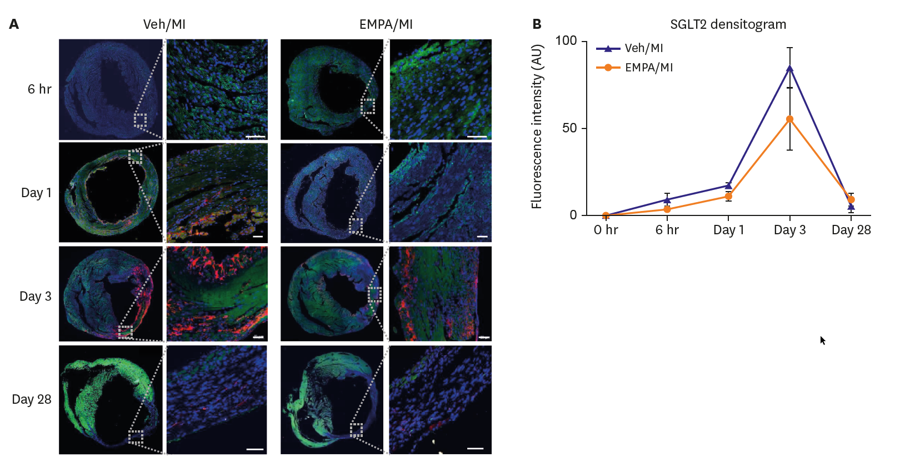
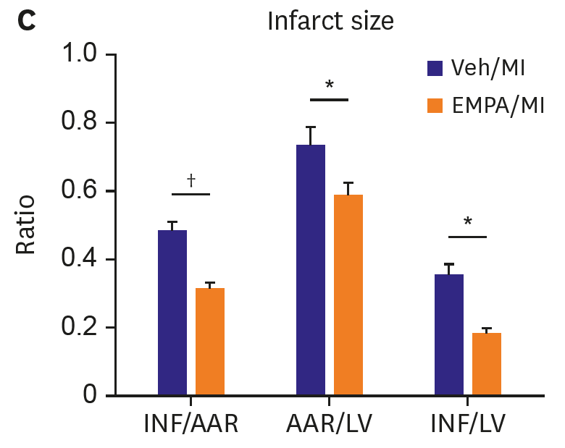
SGLT2 inhibition SGLT2 expressed in mouse myocardial infarction model
Mice myocardial infarction model, pretreated with vehicle or empagliflozin, staining DNA (blue), TnT (green), SGLT2 (red)
Lee et al, Kor Cir J 2021;51:251-62
Notes:
Deze figuur toont een infarctmodel. Dan is er tijdsafhankelijk wel degelijk expressie van SGLT2 kort na inductie van het infarct weinig, en op dag 3 top van de response mn expressie van SGLT2, en in deze plaatjes zie je dat in rood gekleurd, mn in de ischemische zone rondom het infarct. Rechtsonder zie je dan dat met flozin behandeling infarct grootte ook kleiner is (INF infarct area, AAR area at risk; LV linker ventrikel), niet alleen het infarct gebied, maar ook de area at risk voor ischemie
Figure 3. Transient expression of SGLT2 on ischemic mouse heart and suppressed SGLT2 expression on infarcted heart in EMPA treated group. (A) Representative images of time sequence after myocardial infarction. DAPI stains in blue, troponin T stains in green, SGLT2 stains in red. At 6 hours after MI, both group showed no SGLT2 stain. On day 1, in vehicle group, SGLT2 stain in infarcted area was noted, but not in EMPA group. On day 3, both group showed SGLT2 stain mainly on endo- and epicardial area of infarct zone. On day 28, both group showed little SGLT2 stain in infarct zone. (B) SGLT2 densitogram during time sequence showing inter-group difference of fluorescence intensity. EMPA group showing slower rate of increase of SGLT2 intensity and lower peak value than vehicle group (Scale bars: 50 μm).DAPI = 4′,6-diamidino-2-phenylindole; EMPA = empagliflozin; MI = myocardial infarction; SGLT2 = sodium/glucose cotransporter 2; Veh = vehicle; AAR = area at risk; DAPI = 4′,6-diamidino-2-phenylindole; EMPA = empagliflozin; INF = infarct area; LAD = left anterior descending; LV = left ventricular; MI = myocardial infarction; TUNEL = terminal deoxynucleotidyl transferase-mediated dUTP nick endlabeling

Slide 10
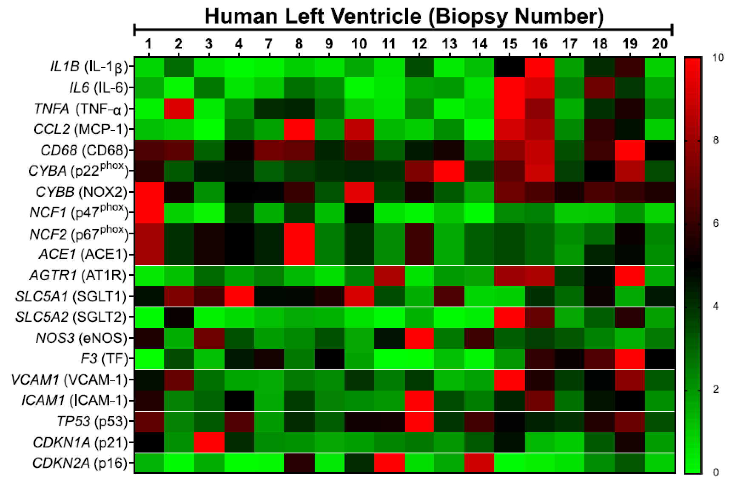
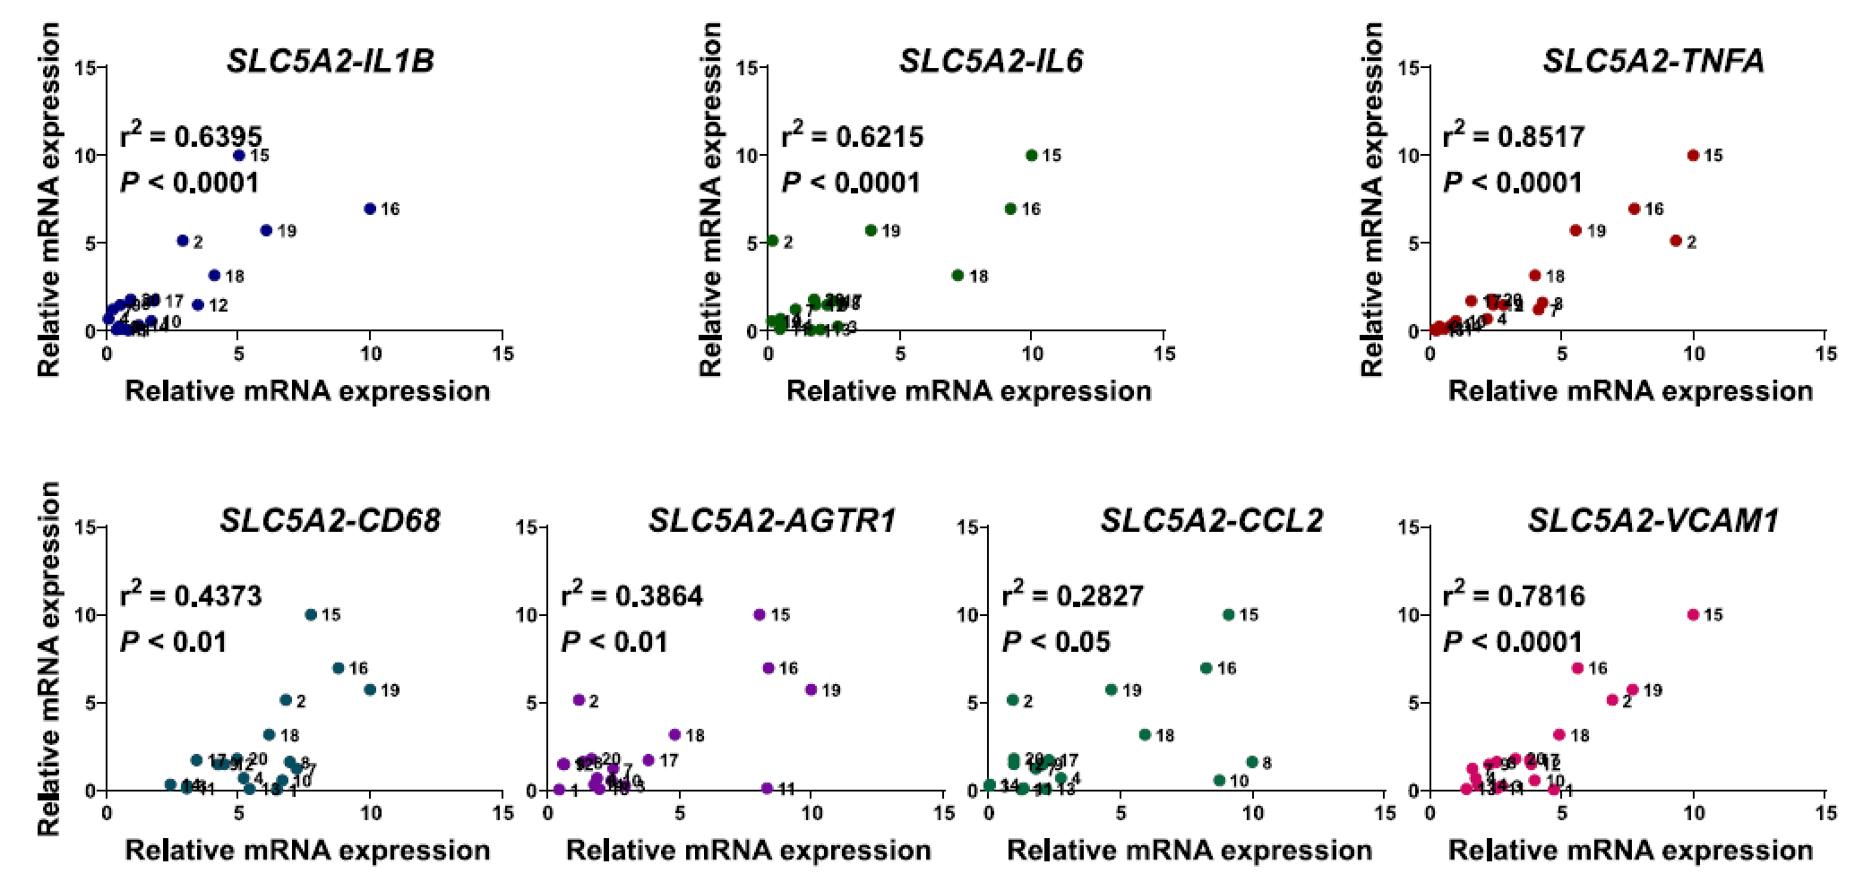
SGLT2 mRNA expression in the human heart Correlation with pro-inflammatory cytokines
*
Biopsies of thoracic artery (n=30) and heart (n=18) of patients undergoing CABG
SGLT2 mRNA expression, heat map and correlations
Mroueh et al, Cardiovascular Research 2025;121:643-57
Notes:
Effecten bij zowel diabeten als niet-diabeten.

Slide 11
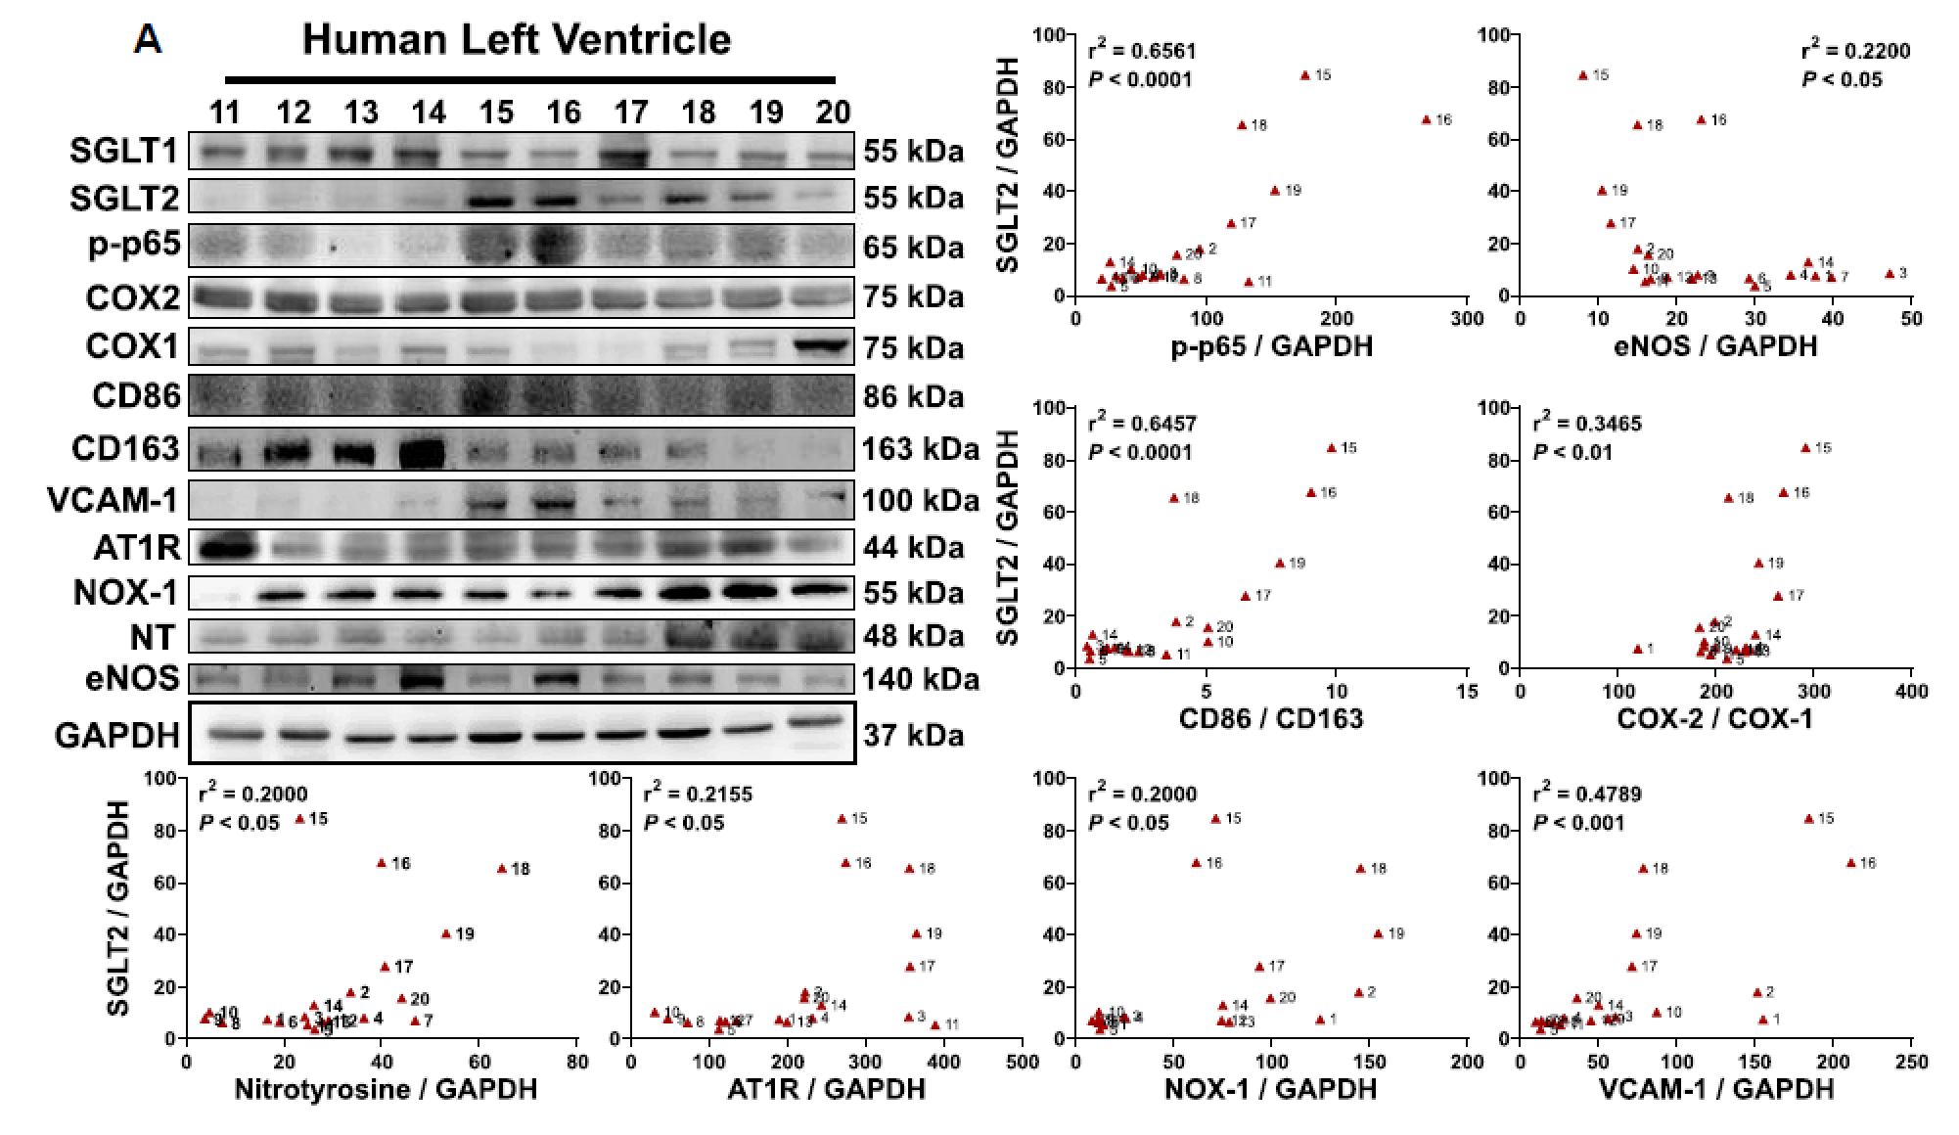
SGLT2 protein expression in the human heart Correlation with pro-inflammatory cytokines
*
Biopsies of thoracic artery (n=30) and heart (n=18) of patients undergoing CABG
Western blot SGLT2 + cytokine protein expression and correlations
Mroueh et al, Cardiovascular Research 2025;121:643-57
Notes:
Effecten bij zowel diabeten als niet-diabeten.

Slide 12
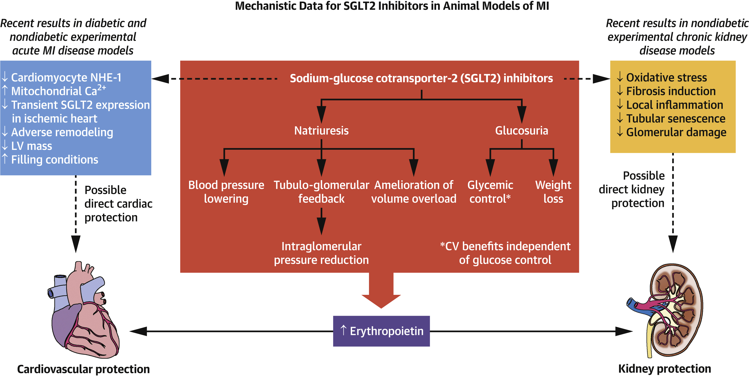
SGLT2 inhibition Pleiotropic, direct effects on the kidney and the heart?
Tubular SGLT2 related effects
Udell et al, J Am Col Cardiol 2022;79:2058-2068
Notes:
Effecten bij zowel diabeten als niet-diabeten.
Quite simply, pleiotropy reflects the fact that most proteins have multiple roles in distinct cell types; thus, any genetic change that alters gene expression or function can potentially have wide-ranging effects in a variety of tissues (Nature)

Slide 13
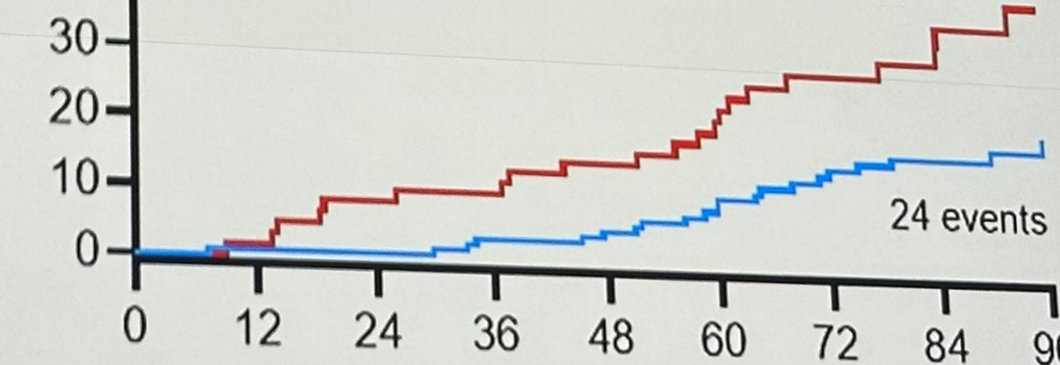
SGLT2 inhibition in CKD stages G4-5 Limited experience
Renal composite outcome
≥50% eGFR decline, eGFR<5 or start of KRT
100
Control
Renal and HF outcome
Renal outcome + incidence HF hospitalization
HR 0.46 (0.25 – 0.82), p=0.008
Renal and CV outcome
Renal outcome + incidence AP, PTCA/CABG, MI, CVA and HF hospitalization
HR 0.53 (0.30 – 0.94), p=0.03
80
Dapagliflozine
HR 0.42 (0.24 – 0.77), P=0.005
60
Cumulative incidence (%)
21 events
40
20
24 events
0
Open label (i.e. no placebo)
Single center
Limited number of patients (n=180)
Powered for n=225, yet terminated early …
0
12
24
36
48
60
72
84
96
Weeks after randomization
Control
60
59
54
53
50
43
30
24
13
Dapagliflozine
120
118
118
114
111
96
82
62
36
RCT, 180 patients CKD stages G4-5 randomized 1:2 to control or dapagliflozin 5-10 mg OD
Chiu Y et al, ASN LBCT session 2024

Slide 14
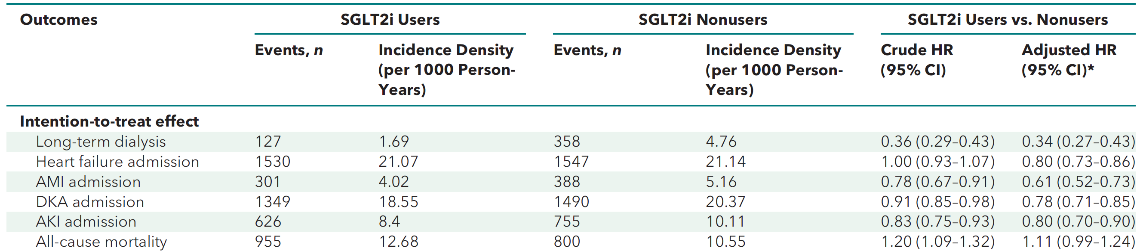
SGLT2 inhibition in KDIGO stage G5 Limited experience
*Adjusted for such as age, sex, race, comorbidities, medication use, duration of diabetes and year of enrollment
Taiwan’s National Health Insurance Research Database, retrospective cohort study, May 2016 to November 2021
All patients with eGFR stage 5 with DM2, sequential target trial emulation, 23,854 SGLT2i users and 23,892 controls
Yen et al, Ann Int Med 2024;177:693-700
Notes:
Effecten bij zowel diabeten als niet-diabeten.

Slide 15
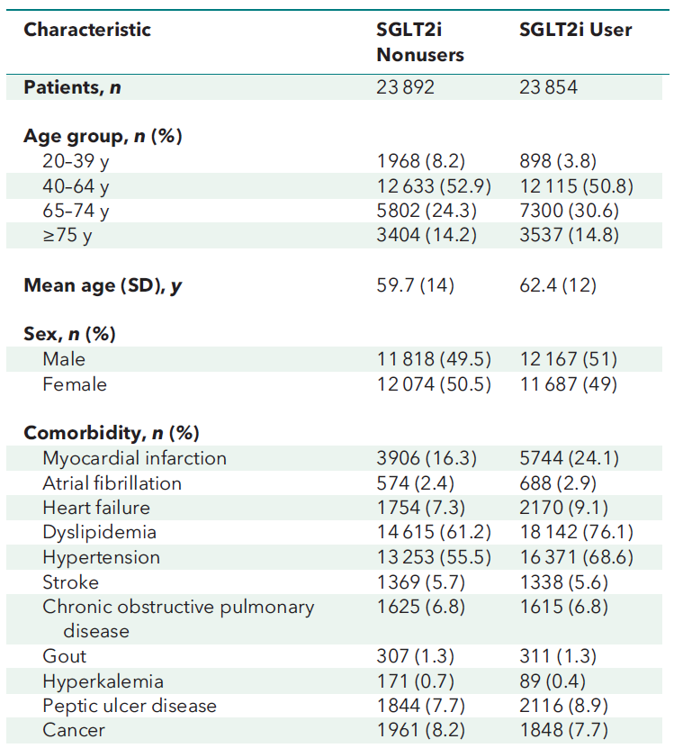
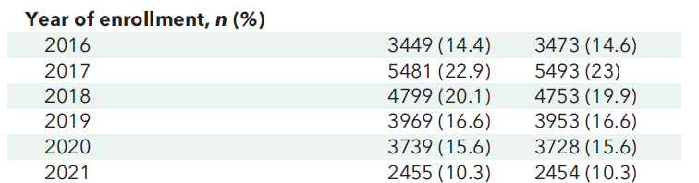
SGLT2 inhibition in KDIGO stage G5 Limited experience
Taiwan’s National Health Insurance Research Database, retrospective cohort study, May 2016 to November 2021
Sequential target trial emulation, 23,854 SGLT2i users and 23,892 controls, all eGFR stage 5 with diabetes
Yen et al, Ann Int Med 2024;177:693-700
Notes:
Effecten bij zowel diabeten als niet-diabeten.

Slide 16
SGLT2 inhibition in dialysis Limited experience
HR 0.64
P<0.01
Post-hoc analysis of the DAPA-CKD trial
Lambers Heerspink et al, Eur Heart J 2021; 42:1216-27
Notes:
Effecten bij zowel diabeten als niet-diabeten.

Slide 17
SGLT2 inhibition in kidney transplant recipients Limited experience
All cause mortality
Death censored graft failure
Doubling sCreat
Korea, retrospective cohort study, 6 transplant centers
226 SGLT2i users and 1857 controls, all KTR with diabetes
Lim et al, Transplantation 2022; 106:e404-12
Notes:
Effecten bij zowel diabeten als niet-diabeten.

Slide 18
SGLT2 inhibition in kidney transplant recipients Limited experience
Korea, retrospective cohort study, 6 transplant centers
226 SGLT2i users and 1857 controls, all KTR with diabetes
Lim et al, Transplantation 2022; 106:e404-12
Notes:
Effecten bij zowel diabeten als niet-diabeten.

Slide 19
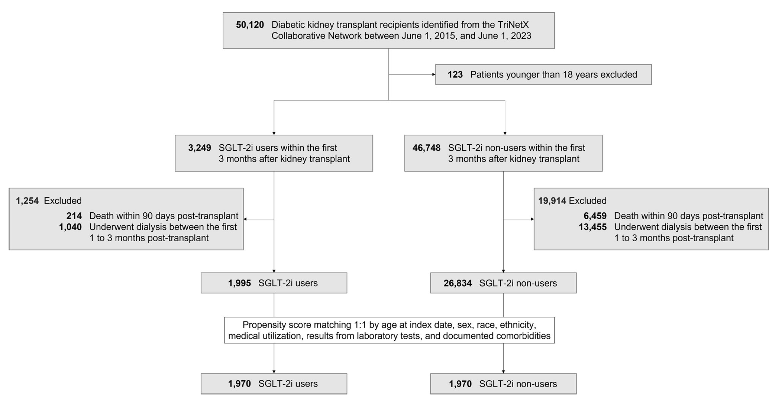
SGLT2 inhibition in kidney transplant recipients Limited experience
International TriNetX database, retrospective cohort study, June 2015 tot June 2023
1.995 SGLT2i users and 26.834 controls, all KTR with diabetes
Sheu et al, Nature Communications 2024;15:10043
Notes:
Effecten bij zowel diabeten als niet-diabeten.

Slide 20
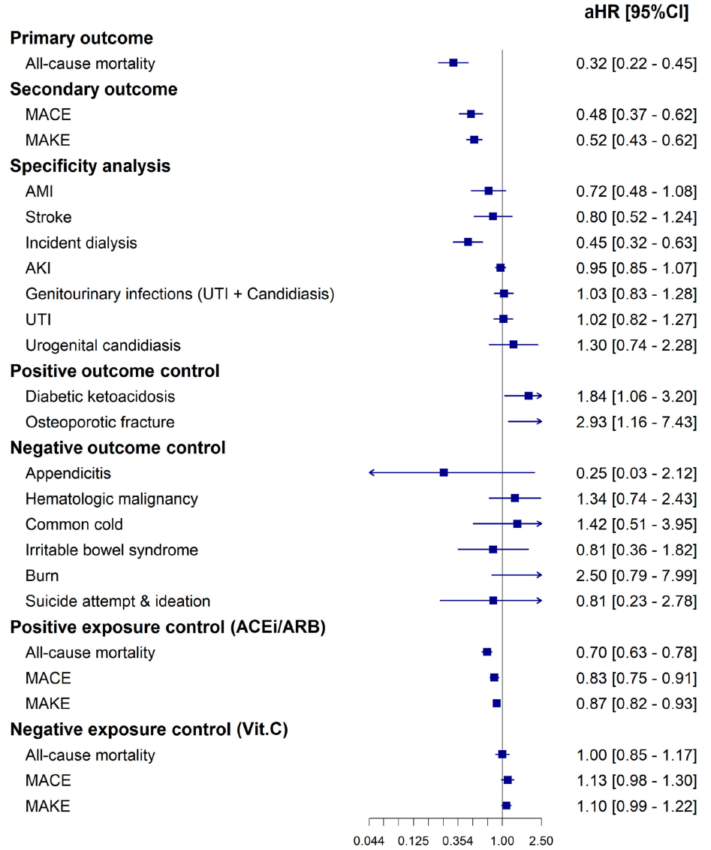
SGLT2 inhibition in kidney transplant recipients Limited experience
*
*Adjusted for such as age, sex, race, comorbidities and medication use
International TriNetX database, retrospective cohort study, June 2015 tot June 2023
1.995 SGLT2i users and 26.834 controls, all KTR with diabetes
Sheu et al, Nature Communications 2024;15:10043
Notes:
Effecten bij zowel diabeten als niet-diabeten.

Slide 21

The Renal Lifecycle trial An Investigator Initiated Study
Endpoints
1) Composite of incidence kidney failure, HF hospitalization, mortality
2a) Incidence of each compontent in the overall population
2b) Incidence of compostie in each subgroup
2c) Safety & tolerability
In total n≃1500-2000 (endpoint driven, n=468)
or 1) severely impaired kidney function; eGFR <25 ml/min/1.73m²
or 2) patients on dialysis
or 3) kidney transplant recipients with an eGFR <45 ml/min/1.73m²
RCT, double-blind, placebo vs dapagliflozin 10 mg, in 1500-2000 patients with severe CKD
ClinicalTrials.gov NCT05374291
Notes:
Effecten bij zowel diabeten als niet-diabeten.

Slide 22
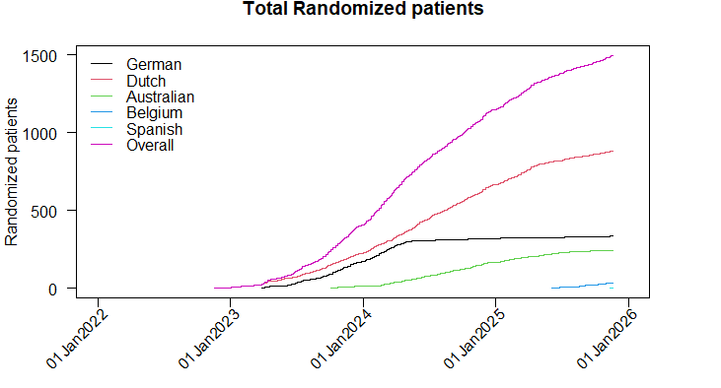
Inclusion overall en per country Per 21 Nov 2025
1505
935
285
243
35
1
RCT, double-blind, placebo vs dapagliflozin 10 mg, in 1500-2000 patients with severe CKD
ClinicalTrials.gov NCT05374291

Slide 23
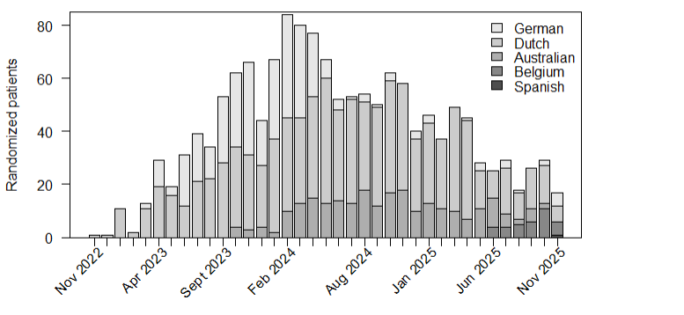
Inclusion per month and country Per 21 Nov 2025
`
RCT, double-blind, placebo vs dapagliflozin 10 mg, in 1500-2000 patients with severe CKD
ClinicalTrials.gov NCT05374291

Slide 24
Inclusion per subgroup Per 21 Nov 2025
RCT, double-blind, placebo vs dapagliflozin 10 mg, in 1500-2000 patients with severe CKD
ClinicalTrials.gov NCT05374291
Notes:
Status at screening

Slide 25
The top 15 includers overall Per 21 Nov 2025
RCT, double-blind, placebo vs dapagliflozin 10 mg, in 1500-2000 patients with severe CKD
ClinicalTrials.gov NCT05374291
Notes:
Effecten bij zowel diabeten als niet-diabeten.

Slide 26
Region UMC Groningen Per 21 Nov 2025
RCT, double-blind, placebo vs dapagliflozin 10 mg, in 1500-2000 patients with severe CKD
ClinicalTrials.gov NCT05374291

Slide 27
Endpoints Per 17 november 2025
 | All-cause mortality | Kidney failure | Hospitalisation for heart failure | Total
CKD | 13 + 2* | 77 | 13 | 103
Dialysis | 30 + 5* | NA | 16 | 51
Kidney transplant | 3 | 13 | 2 | 18
Total | 46 + 7* | 95 | 31** | 172 (+ 32***)
* 7 cases death due to kidney failure to be adjudicated by CAC (((how to categorize them in the CKD group?)))
** 22 HF cases to be adjudicated by CAC
*** new compared to previous SC meeting
RCT, double-blind, placebo vs dapagliflozin 10 mg, in 1500-2000 patients with severe CKD
ClinicalTrials.gov NCT05374291

Slide 28
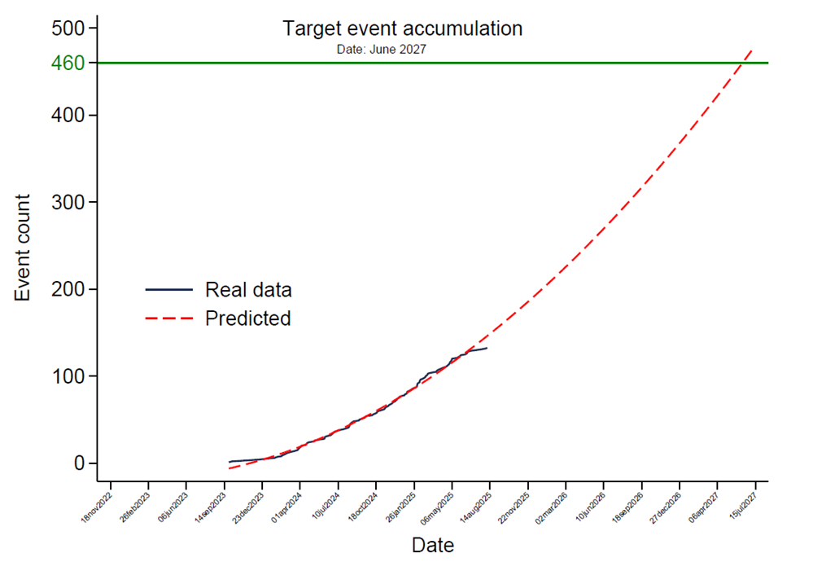
Endpoints Progress November 2025
468
Updated power analysis
Change: 5% discontinuation rate
420
Sept 2025:
N=133 first confirmed endpoints
Nov 2025:
N = 172 first confirmed endpoints
Probably 183 (HF cases + death to KF)
RCT, double-blind, placebo vs dapagliflozin 10 mg, in 1500-2000 patients with severe CKD
Notes:
Effecten bij zowel diabeten als niet-diabeten.

Slide 29
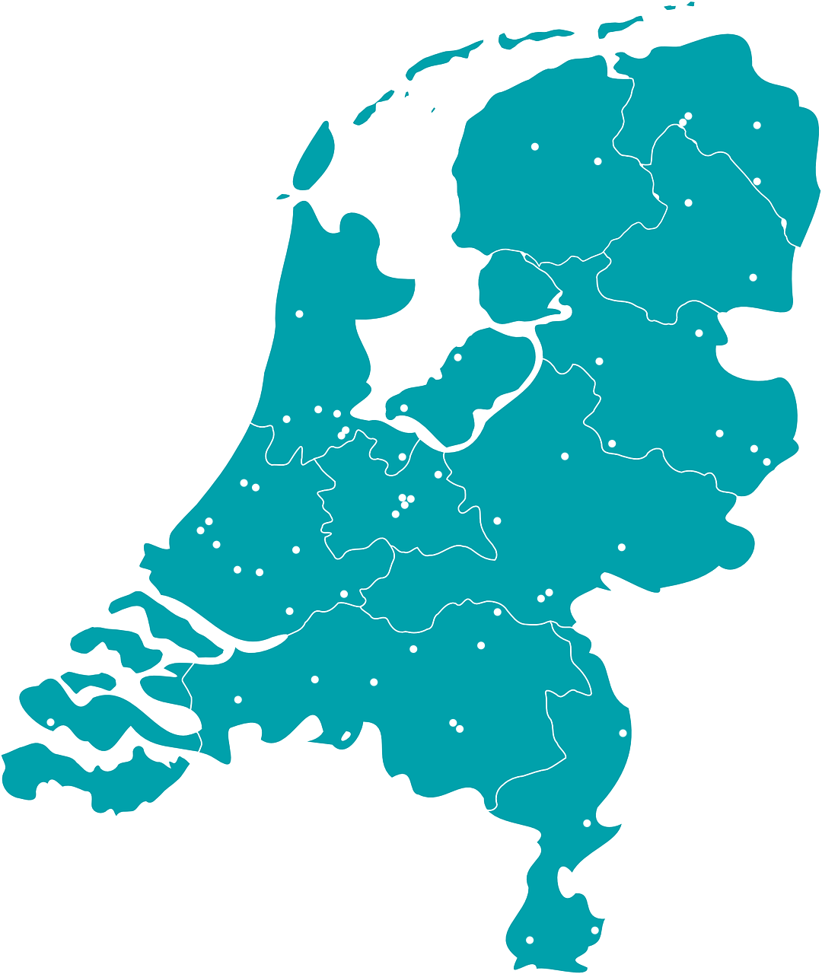
A joint project
The Netherlands
UMC Groningen + 45 sites
Made possible by a legacy from a deceased patient
Belgium prof. Dirk Kuypers 5 sites
Germany prof. Christoph Wanner 17 sites
Australia dr. Sunil Badve 16 sites
Spain dr. Jose Gorriz 13 sites
Singapore prof. Angela Wang 5 sites
RCT, double-blind, placebo vs dapagliflozin 10 mg, in 1500-2000 patients with severe CKD
ClinicalTrials.gov NCT05374291

Slide 30
Baseline characteristics Per November 4, 2025: n=1500
 | CKD N=560 | Dialysis N=465 | Transplant N=417
Male sex, % | 68 | 71 | 64
Age, yr | 69 | 65 | 57
White race, % | 92 | 81 | 89
Hypertension, % | 96 | 92 | 93
RAASi, % | 84 | 56 | 76
Hypercholesterolemia, % | 68 | 62 | 70
Diabetes mellitus, % | 36 | 40 | 20
Cardiovascular disease, % | 34 | 32 | 16
Heart failure, % | 13 | 18 | 4
Hemo / peritoneal dialysis, % |  | 68 / 32
RCT, double-blind, placebo vs dapagliflozin 10 mg, in 1500-2000 patients with severe CKD
ClinicalTrials.gov NCT05374291
Notes:
Effecten bij zowel diabeten als niet-diabeten.

Slide 31
Conclusions
As yet starting SGLT2 inhibitors in case of late-stage CKD should be avoided
Theoretically, this class of drugs could be less effective at low kidney function
Very limited clinical data of low evidence (surprisingly suggesting efficacy)
Experimental data suggest direct effects, independent of SGLT2 in proximal tubules, via non-SGLT2 related mechanisms and by SGLT2 expressed in the heart and vasculature
Safety concern, especially in immune suppressed kidney transplant recipients (UT/genital infections)
The Renal Lifecycle trial has been designed to specifically test the value of SGLT2 inhibition in case of late-stage CKD. This study will have to provide the definitive answer whether the efficacy / safety balance is sufficient in this vulnerable patient group
Notes:
Effecten bij zowel diabeten als niet-diabeten.

Slide 32


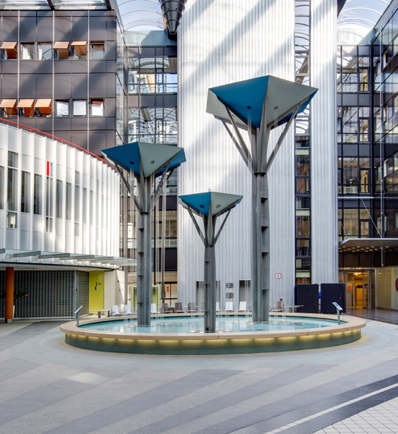







Welcome at the UMC Groningen

Slide 33
Conflicts of interest
Fees for concultancy and/or grants for research from Abbvie, Astra-Zeneca, Baxter, Bayer, Calico, Dutch Kidney Foundation, Dutch Heart Foundation, Galapagos, Happitech, Healthy.io, Health Holland, Mironid, Roche, Sanofi-Genzyme, Otsuka, Vertex and ZonMw
All money is paid to the employing institution (the UMC Groningen)
No stock nor patents

Slide 34
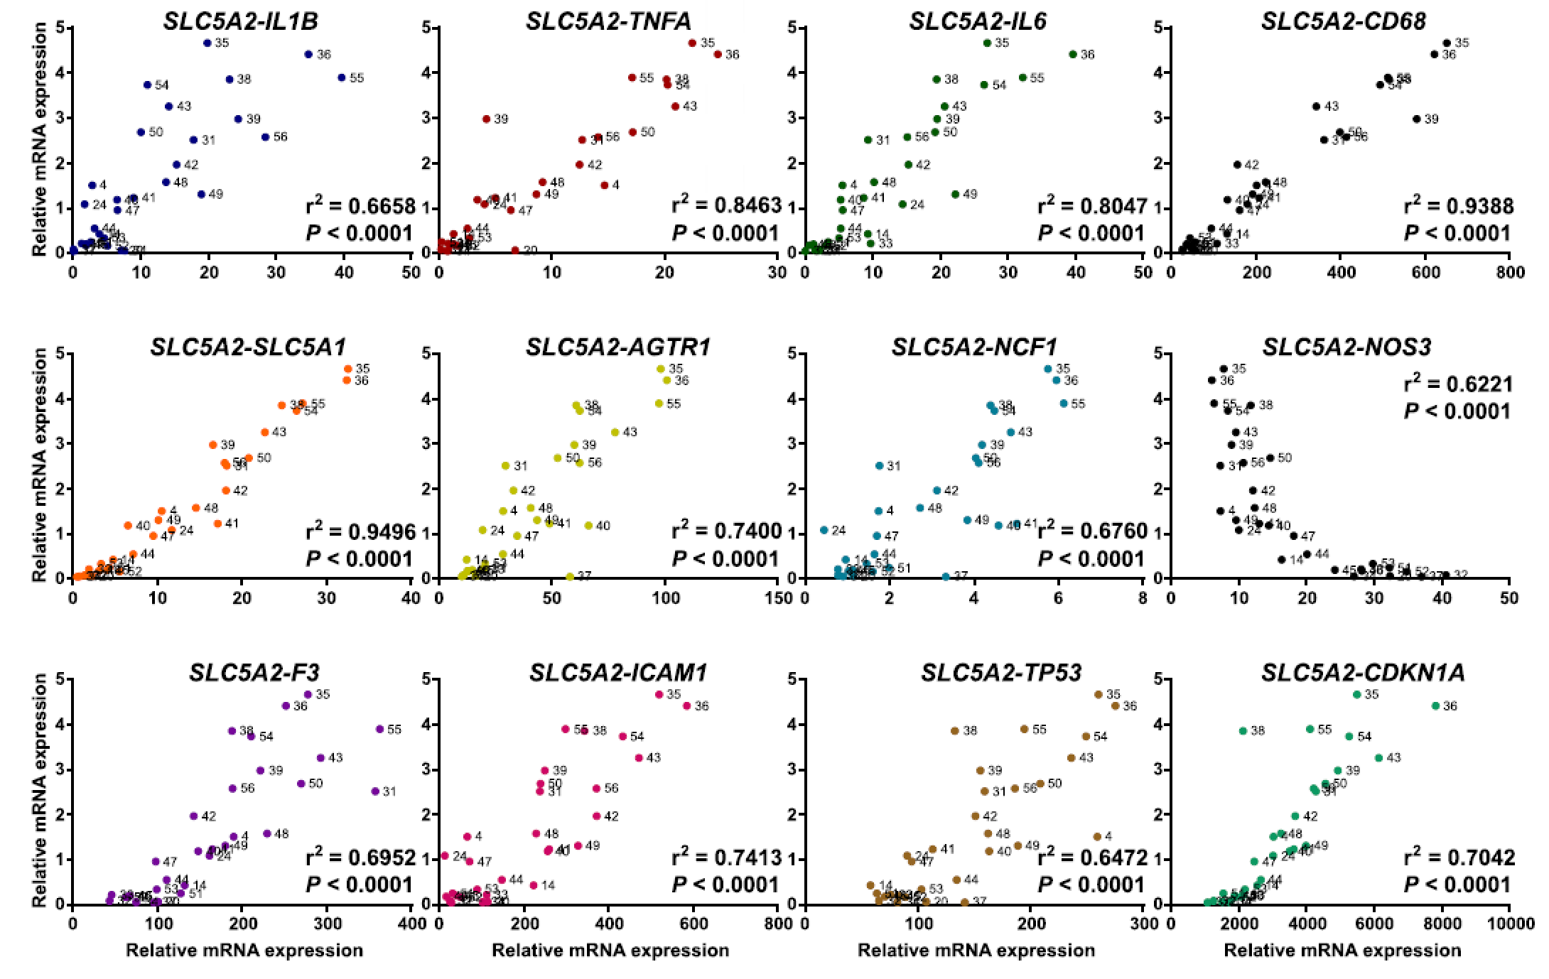
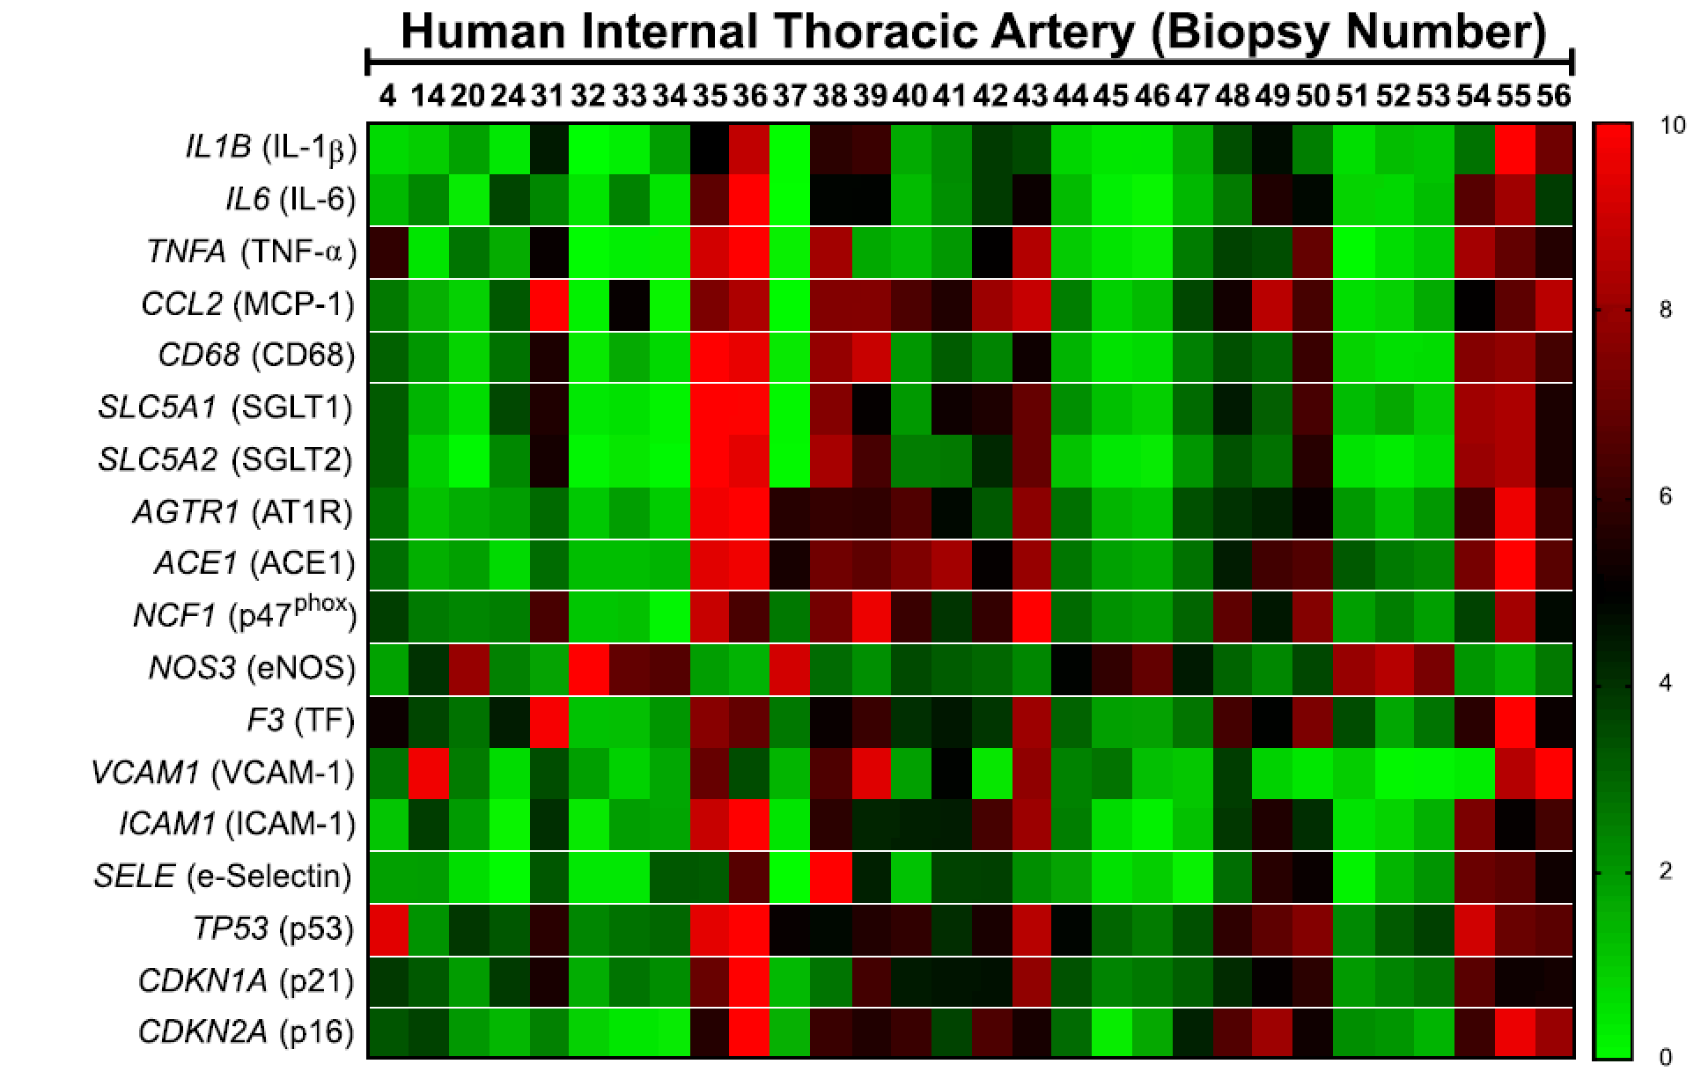
SGLT2 mRNA expression in human vasculature Correlation with pro-inflammatory cytokines and NO
*
Biopsies of thoracic artery (n=30) and heart (n=18) of patients undergoing CABG
SGLT2 mRNA expression, heat map and correlations
Mroueh et al, Cardiovascular Research 2025;121:643-57
Notes:
Effecten bij zowel diabeten als niet-diabeten.

